Slide 1
Java LiveLesson #1
Topic: Debugging, Computer Hardware, Java Compilation & Execution
Monday 9/27/2021

Slide 3
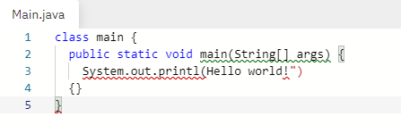
Warm up – debug that code!
Navigate to: https://replit.com/@BrittanyWest1/PerfumedModestAddons
  You can debug in the Repl OR you can copy/paste into BlueJ… OR you can rewrite on paper!

Slide 4
Warm up – debug that code!
class main {
public static void main(String[] args) {
System.out.printl(Hello world!")
{}
}
How many errors?

Slide 5
Warm up – debug that code!
class Main {
public static void main(String[] args) {
System.out.println("Hello world!");
}
}
How many errors? 5

Slide 6
Video
https://www.khanacademy.org/computing/code-org/computers-and-the-internet/how-computers-work/v/khan-academy-and-codeorg-cpu-memory-input-output

Slide 7
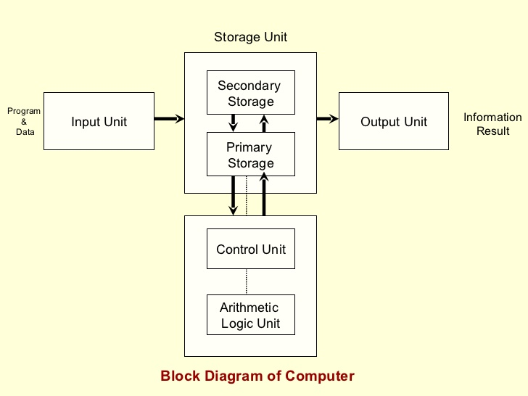
A crash course in computer architecture
Keyboard, mouse, etc
HDD – Hard Disk Drive
Screen, speakers, etc
CPU – Central Processing Unit
RAM – Random Access Memory

Slide 8

What happens when I run my Java program?
Components involved:
  Java source code file (what you wrote in BlueJ or Eclipse)
  Java compiler
  Java Virtual Machine
  Magic!!! (just kidding)

Slide 9
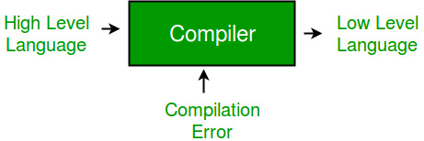
Compiler
What’s a low level language?
What’s a high level language?
Why do we need a compiler?

Slide 10
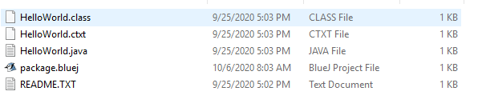
Have you noticed this?

Slide 11
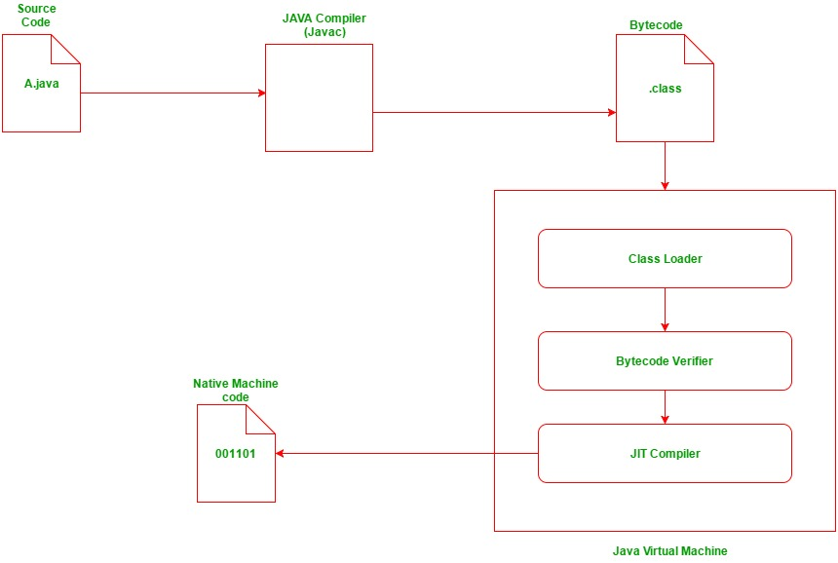
This comes from the JDK
This gets created by the compiler
You create this
The JVM also comes from the JDK
Your computer can read this!

Slide 12
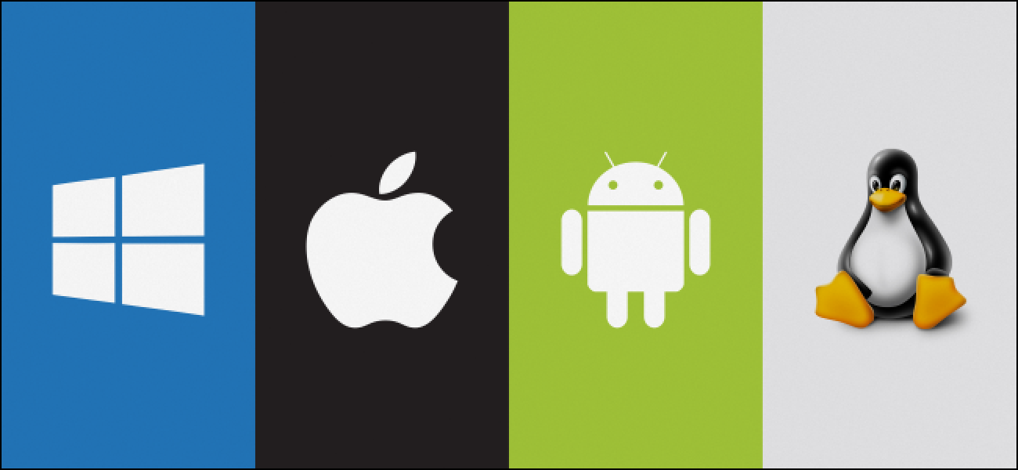
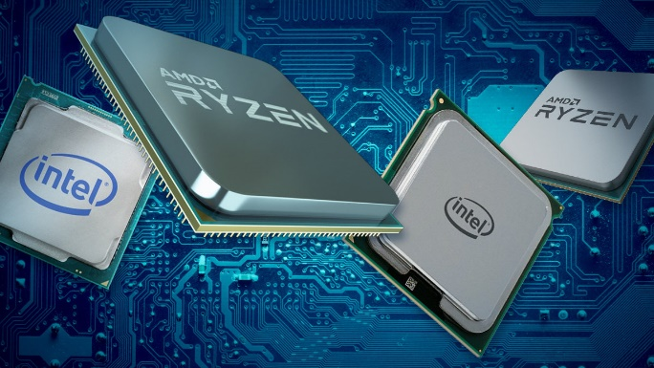
Why do we need a compiler?
Machine dependent vs. independent
  every computer is different!
  Different operating system, different hardware
  A compiler allows us to write code that is machine independent
  In Java, the compiler & JVM together are needed to create native machine code

Slide 13
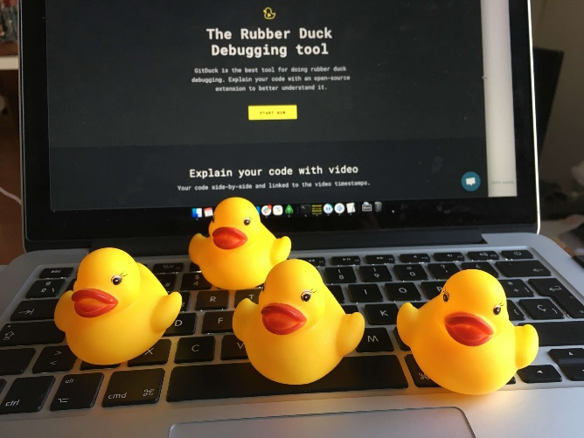
Debugging strategies
Rubber ducky debugging
  https://rubberduckdebugging.com/
What are your favorite strategies?
What are some key things to look for when debugging?

