Slide 1
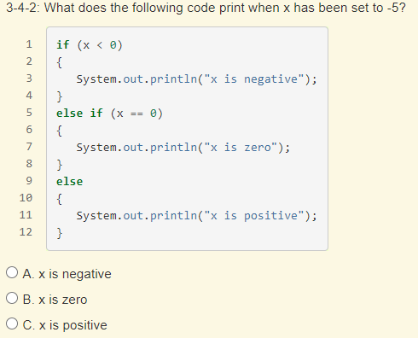
Warm up
Option 1: codingBat > stringTimes
Option 2: Multiple Choice

Slide 2
arrays & loops
AP CSA & Java
Fall 2020

Slide 3
Announcements
Winter break: 12/19 - 1/3
End of semester deadline: February 3 @ 8:59pm
  All work will be accepted until deadline – but NOT after!

Slide 4
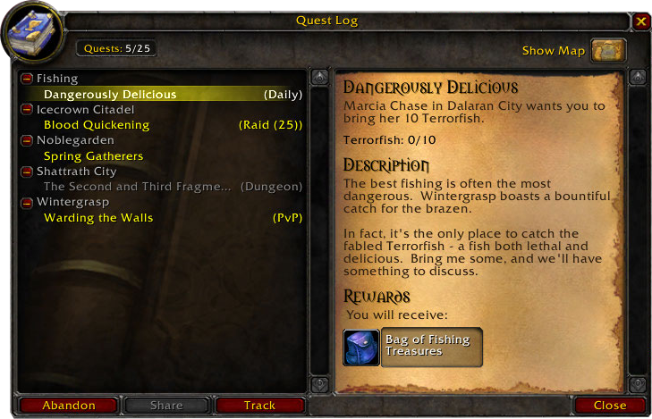
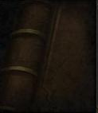

Agenda & Objectives
Arrays
Loops
Arrays
  Represent collections of related primitive or object reference data using one-dimensional (1D) array objects
  Traverse the elements in a 1D array
Loops:
  while loops: represent iterative processes using a while loop
  for loops: represent iterative processes using a for loop

Slide 5
arrays

Slide 6

Arrays Video

Slide 7
Arrays – a list or table of information with one column
My Courses 18-19
Java Programming I
PreCalculus
US History
English
Biology
Students who attend Java LL
Dennis Ritchie
Linus Torvalds
Grace Hopper
Anita Borg
Student Grades
89%
50%
99%
73%
Think of some other data we could organize into an array (or one column of data)!

Slide 8
Values & Indexes
An array stores VALUES. We can access the VALUES later using the INDEX.
Let’s consider the My Courses array.
VALUES
Java Programming I | PreCalculus | US History | English | Biology
INDEXES
0 | 1 | 2 | 3 | 4
The VALUE at INDEX 0 is…… Java Programming I
The VALUE at INDEX 2 is…… US History
First index
Last index

Slide 9
Values & Indexes
We also call the values ELEMENTS of the array.
Array elements have a TYPE. What is the type of these elements?........... String!
ELEMENTS
Java Programming I | PreCalculus | US History | English | Biology
There are 5 elements in this array.
INDEXES
0 | 1 | 2 | 3 | 4
Array LENGTH?
The LENGTH is how many elements are in the array.
What is the LENGTH of this array?............ 5!
notice that 4 = 5 – 1…
last index = length - 1

Slide 10
ELEMENTS
myArray[0] | myArray[1] | myArray[2] | myArray[3] | myArray[4]
INDEXES
0 | 1 | 2 | 3 | 4

Slide 11
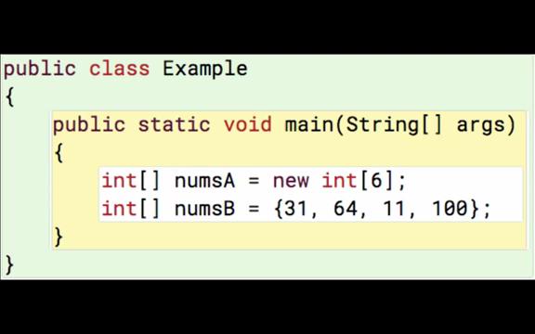
Creating a new array – 2 ways
**default initial values!
when using new, array elements get the following default values, by type:
0 for type int
0.0 for type double
false for boolean
null for String

Slide 12
What values are stored in each array?
{null, null, null, null, null, null, null, null, null, null}
String[] strArray = new String[10];
int[] intArray = new int[2];
boolean[] boolArray = new boolean[5];
double[] doubleArray = new double[4];
{0, 0}
{false, false, false, false, false}
{0.0, 0.0, 0.0, 0.0}

Slide 13
Array Syntax | Formula | Example
Declaration | elementType[] arrayName; | String[] myCourses;
Creation (this step ALLOCATES MEMORY) | arrayName = new elementType [# of elements]; | myCourses = new String[5];
Initialization | elementType[] arrayName = {element1, element2, …. elementN}; | String[] myCourses = {“Java Programming I”, “PreCalculus”, “US History”, “Biology”};
Accessing elements | arrayName[index] | myCourses[2] example: System.out.println(“My first course is “ + myCourses[0]); will print My first course is Java Programming I

Slide 14
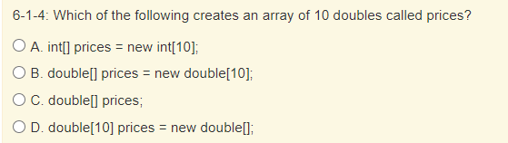

Slide 15
loops

Slide 16
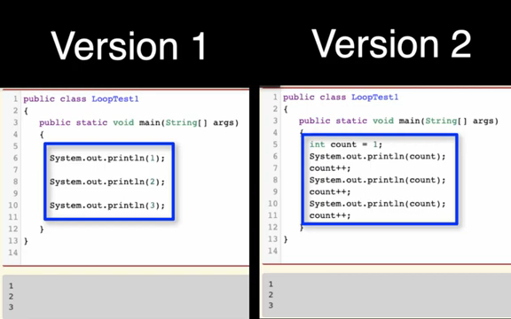
while Loop

Slide 17
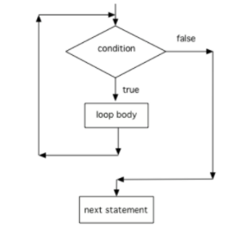
while loop – control flow

Slide 18
3 steps to a loop
initialize loop control variable
test loop control variable
change loop control variable
1. initialize
int count = 1;
while(count >= 10) {
System.out.println(count);
count++;
}
2. test
3. change

Slide 19
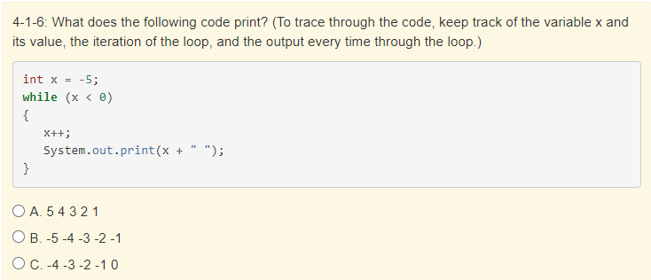

Slide 20
How can we use a while loop to play a guessing game?
What code will we need?
  random number: Math.random()
  int variables: one to store user’s guess, one to store random num
  Scanner object, nextInt() for user input
  println() or print() to print out user input prompt
  while for repeatedly guessing
  boolean expression & relational operators: == or !=

Slide 21
int randNum = 1 + (int)(Math.random()*10);
Scanner input = new Scanner();
int guess = input.nextInt();
while(randNum != guess) {
System.out.println(“Guess again!”);
guess = input.nextInt();
}

Slide 22
3 steps to a loop
initialize loop control variable
test loop control variable
change loop control variable
1. initialize
1. initialize
int count = 1;
while(count >= 10) {
System.out.println(count);
count++;
}
int randNum = 1 + (int)(Math.random()*10);
Scanner input = new Scanner();
int guess = input.nextInt();
while(randNum != guess) {
System.out.println(“Guess again!”);
guess = input.nextInt();
}
2. test
2. test
3. change
3. change

Slide 23
What if I want to traverse, or access all array elements?
int[] intArray = new int[5];
intArray[0] = 1;
intArray[1] = 1;
intArray[2] = 1;
intArray[3] = 1;
intArray[4] = 1;
int[] intArray = new int[5];
int i = 0;
while(i < intArray.length) {
intArray[i] = 1;
i++
}
what is the pattern?
can we use a variable to represent the index?
can we condense this code into fewer lines, with less possibility for error?

Slide 24
What if I want to traverse, or access all array elements?
int[] intArray = new int[5];
intArray[0] = 1;
intArray[1] = 1;
intArray[2] = 1;
intArray[3] = 1;
intArray[4] = 1;
int[] intArray = new int[5];
for(int i = 0; i < intArray.length; i++) {
intArray[i] = 1;
}
what is the pattern?
can we use a variable to represent the index?
can we condense this code into fewer lines, with less possibility for error?

Slide 25
for loops
for (initialize; test condition; change) {
loop body;
}

Slide 26
for vs while
built-in initialization
built-in increment
best for counting
best for traversing arrays
no built-in initialization
no built-in increment
best for complex boolean expressions
repeat code
3 steps (initialize, test, change)
use for when you know how many times loop should execute
use while when you don’t know how many times loop should execute

Slide 27
Common error when using arrays
myCourses
Java Programming I | PreCalculus | US History | English | Biology
for(int i = 0; i <= myCourses.length; i++) {
System.out.println(“Course “ + i + “: “ + myCourses[i]);
}
loop
i
== ?
myCourses
[
i
] == ?
execution
myCourses.length evaluates to?.... 5!
1
0
Java Programming I
starting
value we set
How many times will our for loop execute?.... 6!
2
1
PreCalculus
3
2
US History
4
3
English
5
4
Biology
6
5
????? error!!!
myCourses.length

Slide 28
remember that this is the INDEX, which starts 0
myCourses[5] = ?????
Think about this as stepping out of the bounds of our array, into some other memory location
myCourses
COMPUTER MEMORY

Slide 29
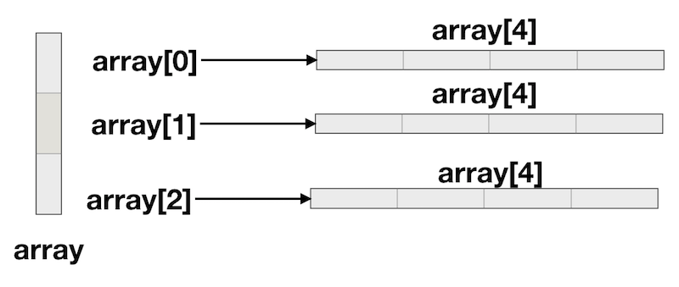
2D arrays??

