Slide 1
Inheritance & POLYMORPHISM!
AP CSA & Java 2022

Slide 2
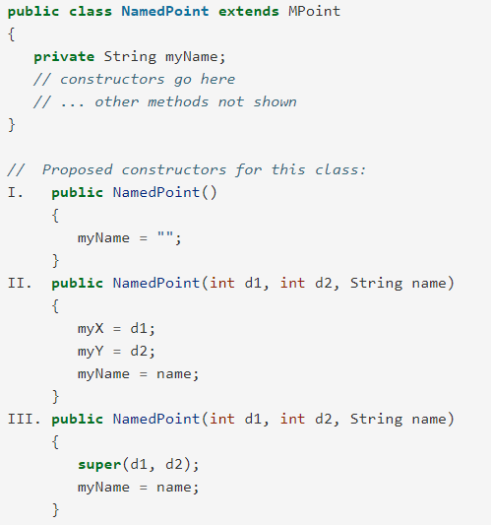
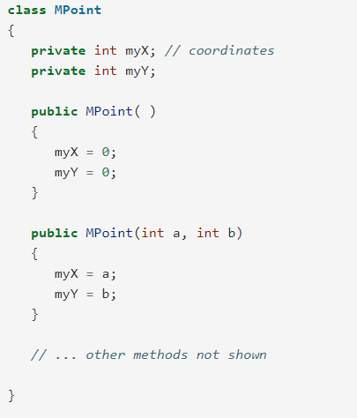
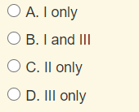
Given the class definitions of MPoint and NamedPoint below, which of the constructors that follow (labeled I, II, and III) would be valid in the NamedPoint class?

Slide 3
Programming Challenge
Make a copy of this Google Doc worksheet: https://docs.google.com/document/d/1LhkVdyRQOtVrSHluYyjiX1fb6gR3CMaRT-4zsD6IVMY/copy
Read instructions and Rectangle class on Page 1
Start making the requested edits to the Square class (comments in green)
When you are done, you can try testing the code in an IDE. You will need BOTH the Rectangle class, and the Square class
Then we’ll do it together!

Slide 4
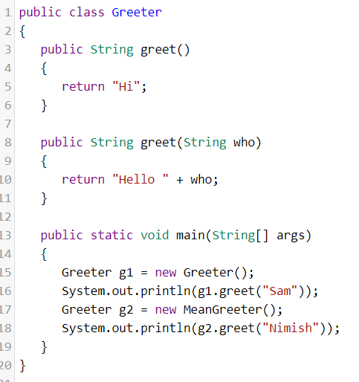
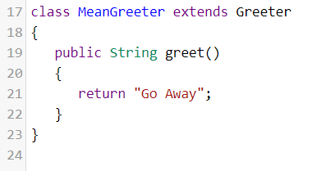
Overloading vs Overriding
What do you notice? What do you wonder?

Slide 5
Overloading vs Overriding
Overloading:
method name is the same
parameter list is different
within ONE class
Overriding:
method signature is the same
  return type, name, parameter list
happens in a subclass (MULTIPLE classes)

Slide 6
Overloading vs Overriding
What do you notice? What do you wonder?
Compiler
JVM

Slide 7
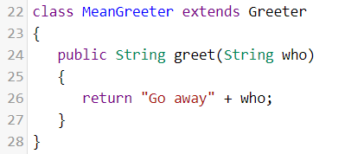
Overloading vs Overriding
What’s different?
Compiler
JVM

Slide 8
Polymorphism
poly = many
morph = forms
3 kinds of polymorphism:
  Polymorphic assignment: Shape s = new Rectangle();
  Polymorphic parameters being called with different subclass types: print(Shape) and print(Rectangle) for method public String print(Shape s)
  Polymorphic array and array list:
    Shape[] shapeArray = { new Rectangle(), new Square() };
Rectangle
Square

Slide 9
