Slide 1
OOP & Inheritance
AP CSA & Java 2022

Slide 2
Video – A REALISTIC Day in the Life of a Stanford Computer Science Major

Slide 3
Rewind/Review OOP!

Slide 4
Anatomy of a class
Data Encapsulation: where the data and code acting on the data are wrapped into a single unit and the implementation details are hidden
Instance variables
  also called attributes
  typically instance variables are private using the access modifier
Methods
  think of as behaviors
  typically are public, but can be private
  Constructors
    used to create instances of the class
  Accessor methods
    used to access the data stored in private instance variables
  Mutator methods
    used to change (mutate) the data stored in private instance variables
  Other instance methods
    may be used to provide behaviors that the object will perform

Slide 5
Class Abstraction & Encapsulation
Class documentation or contract (signatures of public methods and variables)
A “client” or someone who is using your class (maybe a coworker) only sees this
Class implementation
This is hidden - encapsulated

Slide 6
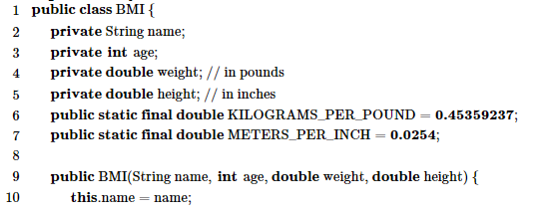
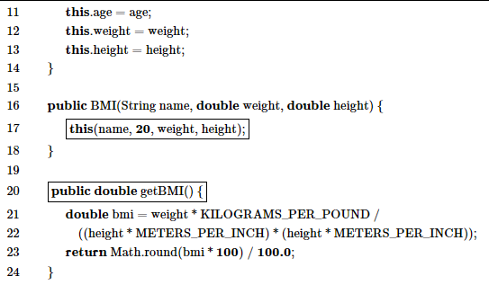
Class Abstraction & Encapsulation
The highlighted areas are what we won’t see if we are using the class, due to class encapsulation

Slide 7
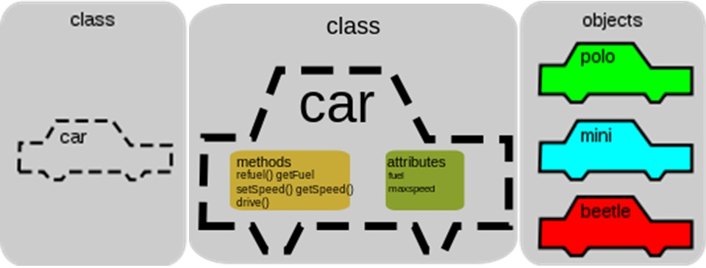
Object Oriented Programming – a big picture!
methods
attributes
refuel() – getFuel()
setSpeed() – getSpeed()
drive()
fuel
speed
color
model

Slide 8

Example Class:
Cat
  attributes:
    color
    hungry
    breed
    bored
    numLives
  methods:
    getColor()
    play()
    eat()
    loseLife()
    setBreed()

Slide 9
OOD or Object Oriented Design
Given a problem, how can you create a class (or multiple classes) that are part of a solution?
When you are given a problem, try looking for the nouns to identify a class
You’ve been hired by your school to create a program that keeps track of “students at your school and the courses they are taking”. Name 2 classes that you would create in your program. Name 2 attributes (data kept in instance variables) for each class.

Slide 10
OOD or Object Oriented Design
Given a problem, how can you create a class (or multiple classes) that are part of a solution?
When you are given a problem, try looking for the nouns to identify a class
You’ve been hired by your school to create a program that keeps track of “students at your school and the courses they are taking”. Name 2 classes that you would create in your program. Name 2 attributes (data kept in instance variables) for each class.

Slide 11
OOD or Object Oriented Design
Say you wanted to make a computer game from a board game that you are playing. Think about what objects are in the game. For example, here is the description for Monopoly (trademark Hasbro games): “Buy, sell, dream and scheme your way to riches. Players buy, sell and trade to win. Build houses and hotels on your properties and bankrupt your opponents to win it all. Chance and Community Chest cards can change everything.” What classes would you need to create a computer version of this game? (Remember to look for the nouns). Take one of the classes you listed, and try to come up with 2 pieces of data in that class that will be the instance variables.

Slide 12
Summary
Programmers use code to represent a physical object or nonphysical concept, real or imagined, by defining a class based on the attributes and/or behaviors of the object or concept.
Instance Variables define the attributes or data needed for objects, and methods define the behaviors or functions of the object.
Data encapsulation is a technique in which the implementation details of a class are kept hidden from the user. The data is kept private with access only through the public methods that can act on the data in the class.
The keywords public and private affect the access of classes, data, constructors, and methods.
The keyword private restricts access to the declaring class, while the keyword public allows access from classes outside the declaring class.
Instance variables are encapsulated by using the private access modifier.
Methods can be public or private, but they are usually public.

Slide 13
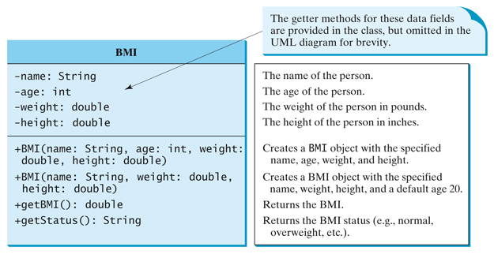
UML Diagram
UML diagram:
used to show a class without showing implementation
(-) mean private variable/method
(+) mean public variable/method
parameters & variables are written in the form: variable name: data type

Slide 14
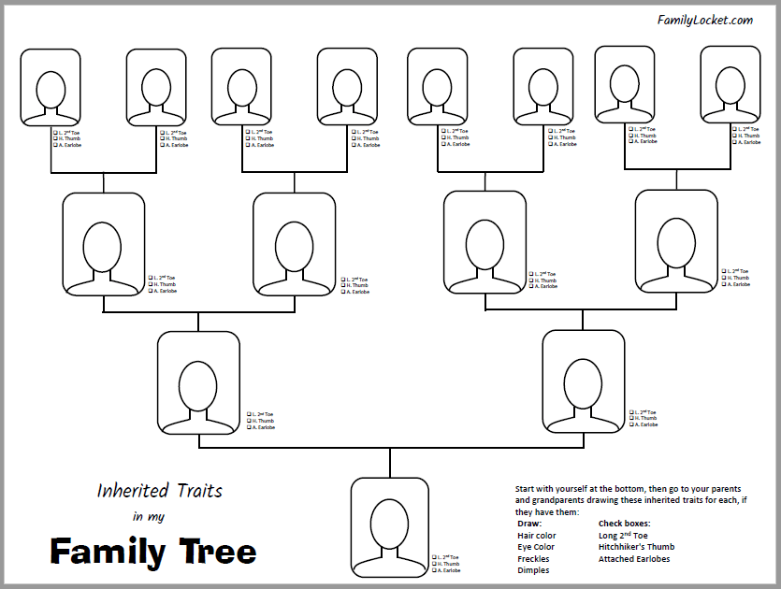

Inheritance
In what contexts have you heard the word inheritance before?

Slide 15

Inheritance
In Java (and OOP generally):
  Classes can inherit attributes (instance variables) and behaviors (methods) from another class
some attributes I inherited:
blonde hair
pale skin
nose shape
child
parent
some behaviors I inherited:
cooking/baking
if you ask me a question I will go on FOREVER
touching all the produce at the grocery store

Slide 16
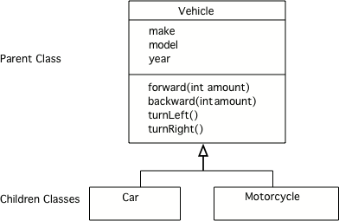
Inheritance
In Java (and OOP generally):
  Classes can inherit attributes (instance variables) and behaviors (methods) from another class
attributes inherited:
make
model
year
parent class
SUPERCLASS
behaviors inherited:
forward
backward
turnLeft
turnRight
child classes
SUBCLASSES

Slide 17
Subclass extends Superclass
public class Car extends Vehicle
public class Motorcycle extends Vehicle
parent class
SUPERCLASS
child classes
SUBCLASSES

Slide 18
Check!
What’s the new Java keyword we learned?
If the class Vehicle has the instance fields make and model and the class Car inherits from the class Vehicle, will a car object have a make and model?
If I had a class ParkingGarage should it inherit from the class Vehicle?
extends
Yes!
No!

Slide 19
Wonder!
What happens if we don’t specify a parent class?
How many parents can a class have?
Automatically inherits from the Object class
1

Slide 20

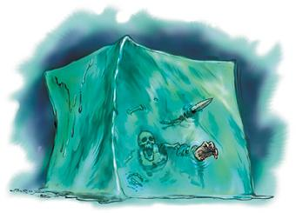
Generalization
2 ways of creating inheritance relationships from a multiple class project: generalization & specialization
Noticing that 2 classes share much of the same data/behavior, and pulling that out into a parent class
Kobold
health
damage
+ move()
+ attack()
+ treasureGather()
GelatinousCube
health
+ move()
+ absorb()

Slide 21
2 ways of creating inheritance relationships from a multiple class project: generalization & specialization
Generalization
Noticing that 2 classes share much of the same data/behavior, and pulling that out into a parent class
Enemy
health
+ move()
Kobold
health
damage
+ move()
+ attack()
+ treasureGather()
GelatinousCube
health
+ move()
+ absorb()
public class GelatinousCube extends Enemy
public class Kobold extends Enemy

Slide 22
2 ways of creating inheritance relationships from a multiple class project: generalization & specialization
Generalization
Noticing that 2 classes share much of the same data/behavior, and pulling that out into a parent class
Enemy
health
+ move()
Kobold
- damage
+ attack()
+ treasureGather()
GelatinousCube
+ absorb()
public class GelatinousCube extends Enemy
public class Kobold extends Enemy

Slide 23
2 ways of creating inheritance relationships from a multiple class project: generalization & specialization
Specialization
Starting with a parent class, and realizing you would like to have another class that does just one thing differently or to add more data
Enemy
health
+ move()
Kobold
- damage
+ attack()
+ treasureGather()
GelatinousCube
+ absorb()
A kobold is an enemy, but also gathers treasure
A gelatinous cube is an enemy, but also can absorb other players and objects

Slide 24
class Person
{
private String name;
}
// How can we make the Student class inherit from class Person?
public class Student
{
private int id;
public static void main(String[] args)
{
Student s = new Student();
System.out.println(s instanceof Student);
System.out.println(s instanceof Person);
}
}
What does instanceof do?

Slide 25

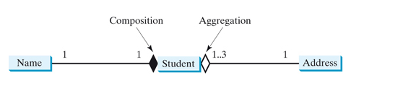
Class Relationships
Association: general binary (two) relationship between classes
Composition & aggregation both refer to ownership – “has a” relationship
Composition means that the object is exclusively owned by the owning (aggregating) object. Names cannot be shared between students, so each name is owned exclusively by each student
Aggregation is ownership that can be shared. Many students can share one address, if the students are all living together. Aggregation is more general than composition.

Slide 26
Student example – has a relationship
public class Name{
private String name;
}
public class Address{
private int streetNum;
private String streetName;
…
}
public class Student {
private Name name;
private Address address;
…
}

Slide 27
Inheritance & Polymorphism Part 1 Tutorials
Part 1 - GeometricShape
Part 2 - Circle
Part 3 - Rectangle & TestGeometric
Part 4 - Super & Constructor Chaining
Part 5 - Overriding Methods & toString()
Part 6 - Object & toString()

Slide 28
Extra!
Use this repl.it: https://repl.it/@BrittanyWest1/ComplexWeakTag
In this project, you will create a class that can tell riddles like the following:
  Riddle Question: Why did the chicken cross the playground?
  Riddle Answer: To get to the other slide!
First, brainstorm to do the Object-Oriented Design for a riddle asking program. What should we call this class? What data does it need to keep track of in instance variables? What is the data type for the instance variables? What methods do we need? (You could draw a Class Diagram for this class using Creately.com, although it is not required).
Using the Person class above as a guide, write a Riddle class in the Active Code template below that has 2 instance variables for the riddle’s question and answer, a constructor that initializes the riddle, and 2 methods to ask the riddle and answer the riddle. Hint: Don’t name your instance variables initQuestion and initAnswer – we’ll explain why shortly. If you came up with other instance variables and methods for this class, you can add those too! Don’t forget to specify the private or public access modifiers. Use the outline in the Active Code below. You will learn how to write constructors and other methods in detail in the next lessons.
Complete the main method to construct at least 2 Riddle objects and call their printQuestion() and printAnswer() methods to ask and answer the riddle. You can look up some good riddles online.

