Slide 1

Welcome to 2nd Semester!

Slide 2
Agenda
OOP Vocab Review
Anatomy of a Class
Object Oriented Design

Slide 3
Creating a Class
What is a class?
  a class is a (data) type
  when we write a class, we’re creating a new type!
What is an object?
  an instance of a class
What is an object reference?
  the variable that points to the contents of that object

Slide 4

Reviewing Object Oriented Programming Vocab

Slide 5
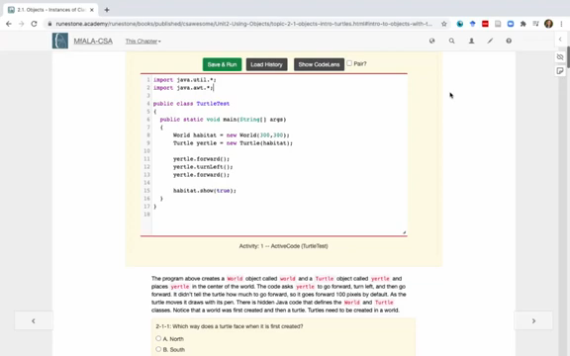
Reviewing Object References

Slide 6


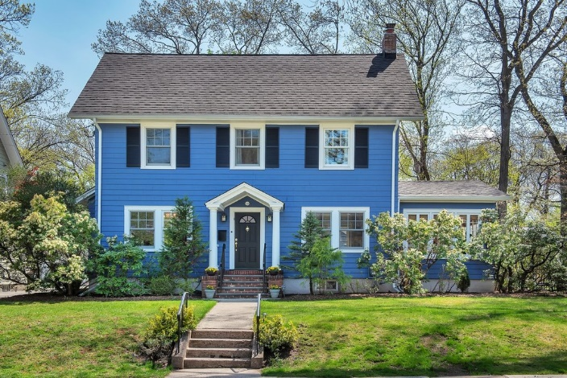
A Class is a Blueprint

Slide 7
A Class is a Blueprint
public class House
{
// define class here – a blueprint
}
House myHouse = new House();
House neighborsHouse = new House();
What is in the red circle?
What are the object references in the code on the right?

Slide 8
Person class visualizer
Java Visualizer – Person Class

Slide 9
Anatomy of a class
Data Encapsulation: where the data and code acting on the data are wrapped into a single unit and the implementation details are hidden
Instance variables
  also called attributes
  typically instance variables are private using the access modifier
Methods
  think of as behaviors
  typically are public, but can be private
  Constructors
    used to create instances of the class
  Accessor methods
    used to access the data stored in private instance variables
  Mutator methods
    used to change (mutate) the data stored in private instance variables
  Other instance methods
    may be used to provide behaviors that the object will perform

Slide 10
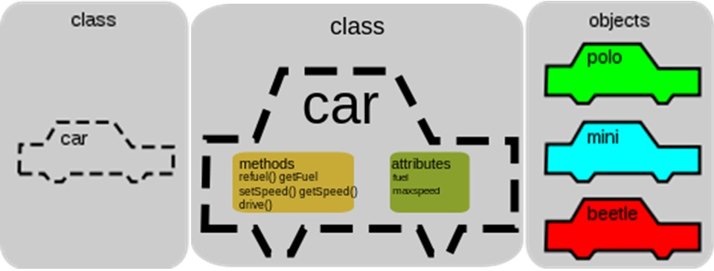
Object Oriented Programming – a big picture!
methods
attributes
refuel() – getFuel()
setSpeed() – getSpeed()
drive()
fuel
speed
color
model

Slide 11

Example Class:
Cat
  attributes:
    color
    hungry
    breed
    bored
    numLives
  methods:
    getColor()
    play()
    eat()
    loseLife()
    setBreed()

Slide 12
OOD or Object Oriented Design
Given a problem, how can you create a class (or multiple classes) that are part of a solution?
When you are given a problem, try looking for the nouns to identify a class
You’ve been hired by your school to create a program that keeps track of “students at your school and the courses they are taking”. Name 2 classes that you would create in your program. Name 2 attributes (data kept in instance variables) for each class.

Slide 13
OOD or Object Oriented Design
Given a problem, how can you create a class (or multiple classes) that are part of a solution?
When you are given a problem, try looking for the nouns to identify a class
You’ve been hired by your school to create a program that keeps track of “students at your school and the courses they are taking”. Name 2 classes that you would create in your program. Name 2 attributes (data kept in instance variables) for each class.

Slide 14
OOD or Object Oriented Design
Say you wanted to make a computer game from a board game that you are playing. Think about what objects are in the game. For example, here is the description for Monopoly (trademark Hasbro games): “Buy, sell, dream and scheme your way to riches. Players buy, sell and trade to win. Build houses and hotels on your properties and bankrupt your opponents to win it all. Chance and Community Chest cards can change everything.” What classes would you need to create a computer version of this game? (Remember to look for the nouns). Take one of the classes you listed, and try to come up with 2 pieces of data in that class that will be the instance variables.

Slide 15
Extra!
Use this repl.it: https://repl.it/@BrittanyWest1/ComplexWeakTag
In this project, you will create a class that can tell riddles like the following:
  Riddle Question: Why did the chicken cross the playground?
  Riddle Answer: To get to the other slide!
First, brainstorm to do the Object-Oriented Design for a riddle asking program. What should we call this class? What data does it need to keep track of in instance variables? What is the data type for the instance variables? What methods do we need? (You could draw a Class Diagram for this class using Creately.com, although it is not required).
Using the Person class above as a guide, write a Riddle class in the Active Code template below that has 2 instance variables for the riddle’s question and answer, a constructor that initializes the riddle, and 2 methods to ask the riddle and answer the riddle. Hint: Don’t name your instance variables initQuestion and initAnswer – we’ll explain why shortly. If you came up with other instance variables and methods for this class, you can add those too! Don’t forget to specify the private or public access modifiers. Use the outline in the Active Code below. You will learn how to write constructors and other methods in detail in the next lessons.
Complete the main method to construct at least 2 Riddle objects and call their printQuestion() and printAnswer() methods to ask and answer the riddle. You can look up some good riddles online.

Slide 16
Summary
Programmers use code to represent a physical object or nonphysical concept, real or imagined, by defining a class based on the attributes and/or behaviors of the object or concept.
Instance Variables define the attributes or data needed for objects, and methods define the behaviors or functions of the object.
Data encapsulation is a technique in which the implementation details of a class are kept hidden from the user. The data is kept private with access only through the public methods that can act on the data in the class.
The keywords public and private affect the access of classes, data, constructors, and methods.
The keyword private restricts access to the declaring class, while the keyword public allows access from classes outside the declaring class.
Instance variables are encapsulated by using the private access modifier.
Methods can be public or private, but they are usually public.

