Slide 1
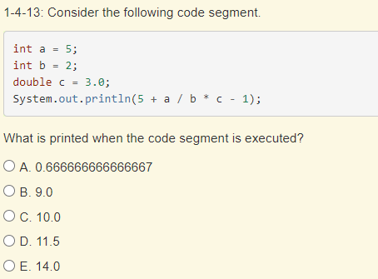
Warm Up
Warm Ups!
Option 1: Debug this repl.it. What is the output when it finally runs?
Option 2: Multiple choice practice:
Option 3: Codingbat Warmup-1 > missingChar

Slide 2
Java LiveLesson #2
Topics: Operators, Assignment, Input/Output
10/11 - Recording

Slide 3
Warm Up review
Solution to Option 1
7 errors
Solution to Option 2
C. 10.0
Solution to Option 3
click “show solution” on codingbat problem

Slide 4

Operators Review
Complete Matching Worksheet - 10 minutes
When you are done, evaluate this expression and post value in the chat:
  5 + 6 % 11 - 2 * (6 + 2)
    answer: -5

Slide 5
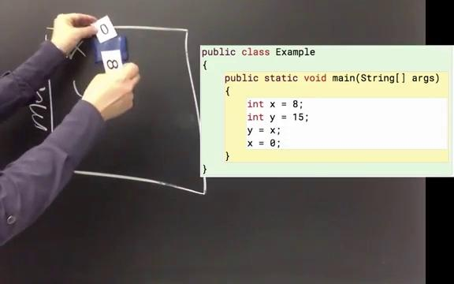
Assignment & Variables

Slide 6
Assignment & Variables
variables - a named spot in memory that we can access multiple times
assignment - we use to store values in variables (memory)

Slide 7
Variables are like parking spaces…

Slide 8


Parking space
A1 | A2 | A3 | A4 | A5
B1 | B2 | B3 | B4 | B5
A1 = variable name (identifier)
cars = value of variable

Slide 9
Parking space
A6
bus
A1 compact | A2 compact | A3 compact | A4 compact | A5 compact
B1 | B2 | B3 | B4 | B5
A1 = variable name (identifier)
cars = value of variable
bus/compact = type

Slide 10
Data types
What is data? What is a type?
Our computers need a way of categorizing data (chunks of information) so that it knows how to treat them, and how to store them in memory
data type | description
int | for storing whole numbers (integers)
double | for storing numbers that have a fractional part
String | for storing text (strings of characters)

Slide 11
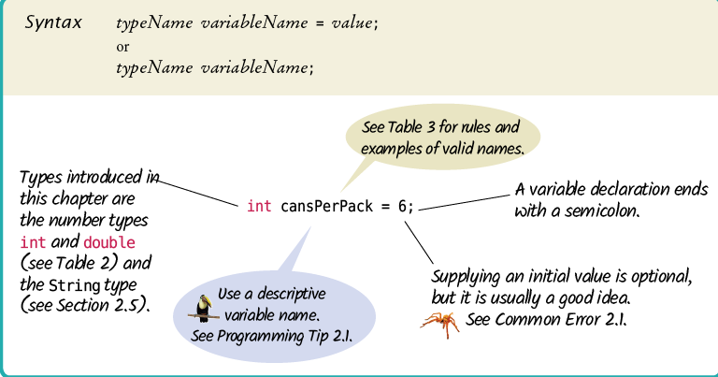
Variable Declarations
this is called initialization – when we give a variable a starting value

Slide 12
Examples of Variable Declarations
Correct? | Declaration | Explanation
 | int cans = 6;
 | int total = cans + bottles;
 | bottles = 1;
 | int volume = “2”;
 | int cansPerPack;
 | int dollars, cents;

Slide 13
Examples of Variable Declarations
Correct? | Declaration | Explanation
✔ | int cans = 6; | Declares an integer variable and initializes it with 6
 | int total = cans + bottles;
 | bottles = 1;
 | int volume = “2”;
 | int cansPerPack;
 | int dollars, cents;

Slide 14
Examples of Variable Declarations
Correct? | Declaration | Explanation
✔ | int cans = 6; | Declares an integer variable and initializes it with 6
? | int total = cans + bottles; | Declares integer and initializes it with the sum of two other variables. Both cans & bottles have to have been declared & initialized previously.
 | bottles = 1;
 | int volume = “2”;
 | int cansPerPack;
 | int dollars, cents;

Slide 15
Examples of Variable Declarations
Correct? | Declaration | Explanation
✔ | int cans = 6; | Declares an integer variable and initializes it with 6
? | int total = cans + bottles; | Declares integer and initializes it with the sum of two other variables. Both cans & bottles have to have been declared & initialized previously.
🗶 | bottles = 1; | Error: missing type. If bottles has already been declared, this would reassign the value of the variable.
 | int volume = “2”;
 | int cansPerPack;
 | int dollars, cents;

Slide 16
Examples of Variable Declarations
Correct? | Declaration | Explanation
✔ | int cans = 6; | Declares an integer variable and initializes it with 6
? | int total = cans + bottles; | Declares integer and initializes it with the sum of two other variables. Both cans & bottles have to have been declared & initialized previously.
🗶 | bottles = 1; | Error: missing type. If bottles has already been declared, this would reassign the value of the variable.
🗶 | int volume = “2”; | Error: mismatch type. Cannot initialize int with a String
 | int cansPerPack;
 | int dollars, cents;

Slide 17
Examples of Variable Declarations
Correct? | Declaration | Explanation
✔ | int cans = 6; | Declares an integer variable and initializes it with 6
? | int total = cans + bottles; | Declares integer and initializes it with the sum of two other variables. Both cans & bottles have to have been declared & initialized previously.
🗶 | bottles = 1; | Error: missing type. If bottles has already been declared, this would reassign the value of the variable.
🗶 | int volume = “2”; | Error: mismatch type. Cannot initialize int with a String
✔ | int cansPerPack; | Declares an integer variable and doesn’t initialize it
 | int dollars, cents;

Slide 18
Examples of Variable Declarations
Correct? | Declaration | Explanation
✔ | int cans = 6; | Declares an integer variable and initializes it with 6
? | int total = cans + bottles; | Declares integer and initializes it with the sum of two other variables. Both cans & bottles have to have been declared & initialized previously.
🗶 | bottles = 1; | Error: missing type. If bottles has already been declared, this would reassign the value of the variable.
🗶 | int volume = “2”; | Error: mismatch type. Cannot initialize int with a String
✔ | int cansPerPack; | Declares an integer variable and doesn’t initialize it
? | int dollars, cents; | Declares two integer variables on the same line – this compiles but isn’t considered good style

Slide 19
Java Visualizer
what does variable assignment look like?
Java Visualizer tool

Slide 20
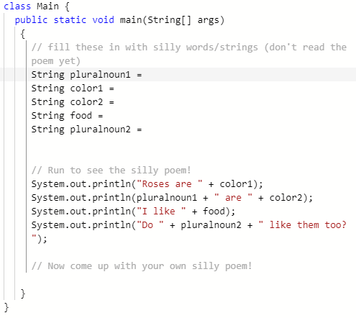
Mad Libs Programming Challenge
use string literals to define the String variables and print a fun madlib poem
Super Challenge: use user input with Scanner to create a more realistic MadLibs program!
Repl.it

Slide 21
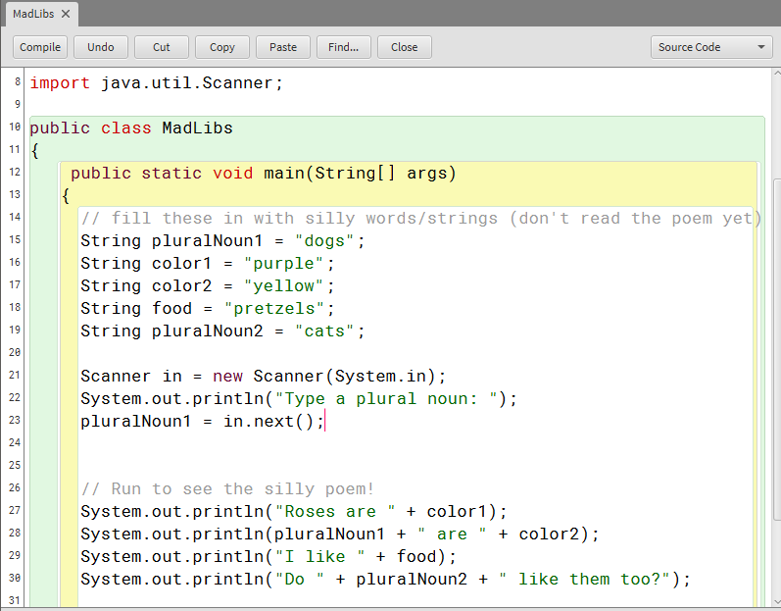
How can we add user input to our MadLibs program?

