Slide 1
Unit 6 Adapting To Your Audience
Public Speaking Ms. Emuge

Slide 2
Objectives
At the end of this lesson, you will be able to do the following:
Devise strategies for adapting to audience feedback

Slide 3
Adapting to Your Audience as You Speak
So far, we have focused on discovering as much as possible about an audience before the speaking event. Prespeech analysis help with each step of the public-speaking process: selecting a topic, formulating a specific purpose, gathering supporting material, identifying major ideas, organizing the speech, and planning its delivery. Each of these components depends on your understanding your audience. But audience analysis and adaptation do not end when you have crafted your speech. They continue as you deliver your speech.
Generally, a public speaker does not have an exchange with the audience unless the speech is part of a question-and-answer or discussion format. Once the speech is in progress, the speaker must rely on nonverbal cues from the audience to judge how people are responding to the message.

Slide 4
Developing Your Speech Step By Step
Consider Your Audience
A Chinese proverb says that a journey of a thousand miles begins with a single step. Developing and delivering a speech may seem like a daunting journey. But we believe that if you take it one step at a time and keep your focus on your audience, you'll be rewarded with a well-crafted and well-delivered message.

Slide 5
Identifying Nonverbal Audience Cues
Once, when speaking in India, Mark Twain was denied eye contact with his listeners by a curtain separating him from his audience. Mark Twain's daughter, Clara, recalled this experience:
One of Father's first lectures was before a Purdah audience; in other words, the women all sat behind a curtain through which they could peek at Mark Twain without being seen by him … a deadly affair for the poor humorist, who had not even the pleasure of scanning the faces of his mute audience. 20
Mark Twain missed learning how well his speech was being received as he was speaking. You could experience the same disadvantage if you fail to look at your listeners while you speak.

Slide 6
Nonverbal Audience Cues
Many beginning public speakers may find it challenging at first not only to have the responsibility of presenting a speech they have rehearsed, but also to have to change or modify that speech on the spot. We assure you that with experience you can develop the sensitivity to adapt to your listeners, much as a jazz musician adapts to the other musicians in the ensemble. But it will take practice. Although it's not possible to read your listeners’ minds, it is important to analyze and adapt to cues that can enhance the effectiveness of your message. The first step in developing this skill is to be aware of the often unspoken cues that let you know whether your audience either is hanging on every word or is bored. After learning to “read” your audience, you then need to consider developing a repertoire of behaviors to help you better connect with your listeners.

Slide 7
Eye Contact
Perhaps the best way to determine whether your listeners are maintaining interest in your speech is to note the amount of eye contact they have with you. The more contact they have, the more likely it is that they are listening to your message. If you find them repeatedly looking at their watches, looking down at the program (or, worse yet, closing their eyes), you can reasonably guess that they have lost interest in what you're talking about.

Slide 8
Facial Expression
Another clue to whether an audience is with you is facial expression. Members of an attentive audience not only make direct eye contact but also have attentive facial expressions. Beware of a frozen, unresponsive face; we call this sort of expression the “listener-stupor” look. The classic listener-stupor expression consists of a slightly tilted head, a faint, frozen smile, and often a hand holding up the chin. This expression may give the appearance of interest, but more often it means that the person is daydreaming or thinking of something other than your topic.

Slide 9
Movement
An attentive audience doesn't move much. An early sign of inattentiveness is fidgeting fingers, which may escalate to pencil wagging, leg jiggling, and arm wiggling. Seat squirming, feet shuffling, and general body movement often indicate that members of the audience have lost interest in your message.

Slide 10
Nonverbal Responsiveness
Interested audience members respond verbally and nonverbally when encouraged or invited to do so by the speaker. When you ask for a show of hands and audience members sheepishly look at one another and eventually raise a finger or two, you can reasonably infer lack of interest and enthusiasm. Frequent applause and nods of agreement with your message are indicators of interest and support.

Slide 11
Verbal Responsiveness
Not only will audiences indicate agreement nonverbally, some will also indicate their interests verbally. Audience members may shout out a response or more quietly express agreement or disagreement to people seated next to them. A sensitive public speaker is constantly listening for verbal reinforcement or disagreement.

Slide 12
Responding to Nonverbal Cues
The value in recognizing nonverbal cues from your listeners is that you can respond to them appropriately. If your audience seems interested, supportive, and attentive, your prespeech analysis has clearly guided you to make proper choices in preparing and delivering your speech.
When your audience becomes inattentive, however, you may need to make some changes while delivering your message. If you think audience members are drifting off into their own thoughts or disagreeing with what you say, or if you suspect that they don't understand what you are saying, then a few spontaneous adjustments may help. It takes experience and skill to make on-the-spot changes in your speech. Consider the tips from seasoned public speakers for adapting to your listeners listed in Table 4.5 on page 102. 21

Slide 13
Responding to Nonverbal Cues
Remember, it is not enough to note your listeners’ characteristics and attitudes. You must also respond to the information you gather by adapting your speech to retain their interest and attention. Moreover, you have a responsibility to ensure that your audience understands your message. If your approach to the content of your speech is not working, alter it and note whether your audience's responses change. If all else fails, you may need to abandon a formal speaker-listener relationship with your audience and open up your topic for discussion. In your speech class your instructor may expect you to keep going, to fulfill the requirements for your assignment. With other audiences, however, you may want to consider switching to a more interactive question-and-answer session to ensure that you are communicating clearly. Later chapters on supporting material, speech organization, and speech delivery will discuss other techniques for adjusting your style while delivering your message.

Slide 14
Recap: Reading Audience Cues
Identify and respond to nonverbal cues that your audience is bored, doesn't understand, or disagrees:
Lack of eye contact
“Listener-stupor” expression
Physical restlessness
No response to humor, speaker invitations
Talking to other listeners

Slide 15
Strategies for Customizing Your Message to Your Audience
Many people value having something prepared especially for them. Perhaps you've bought a computer that you ordered to your exact specifications. In a restaurant you order food prepared to your specific taste. Audiences, too, prefer messages that are adapted just to them; they don't like hearing a canned message. As a speaker, you may have worked hard to adapt your message to your audience, but your audience won't give you credit for it unless you let them know that you've done so. What are some ways to communicate to your listeners that your message is designed specifically for them? Here are a few suggestions:

Slide 16
Appropriately use audience members’ names.
Consider using audience members’ names in your talk to relate specific information to individual people. Obviously, you don't want to embarrass people by using them in an example that would make them feel uncomfortable. But you can selectively mention people you know who are in the audience. It's become a standard technique in many State of the Union speeches for the president to have someone sitting in the balcony who can be mentioned in his talk. That person becomes a living visual aid to provide focus on an idea or a point made in the address. If you are uncertain whether you should mention someone by name, before you speak, ask the person for permission to use his or her name in your talk.

Slide 17
Refer to the town, city, or community.
Make a specific reference to the place where you are speaking. If you are speaking to a college audience, relate your message and illustrations to the school where you are speaking. Many politicians use this technique: They have a standard stump speech to tout their credentials but adapt the opening part of their message to the specific city or community in which they are speaking.

Slide 18
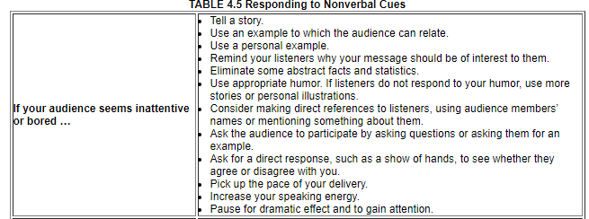
Responding to Nonverbal Cues

Slide 19
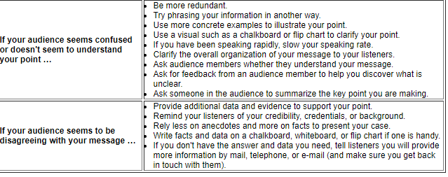
Responding To Nonverbal Cues

Slide 20
Refer to a significant event that happened on the date of your speech.
Most libraries have books (such as the Speaker's Lifetime Library) that identify significant events in world or national history. 22 An even easier way to find out what happened on any given day in history is to go to www.history.com and click on the link called “This Day in History.” Type in date and you'll quickly discover any number of events that occurred on that day. For example, on the day this paragraph was written, Julius Caesar was assassinated in 44 B.C.E. It's also known as the Ides of March—a day Caesar was warned about in Shakespeare's famous play. If you were giving a speech on this day, a reference to the Ides of March might be especially apropos if your goal was to encourage your audience to beware of whatever issue or topic you were discussing.

Slide 21
Refer to a significant event that happened on the date of your speech. cont...
Many newspapers keep records of local historical events and list what happened 10, 25, or 50 years ago on a certain date. Relating your talk to a historical event that occurred on the same date as your talk can give your message a feeling of immediacy. It tells your audience that you have thought about this specific speaking event.

Slide 22
Refer to a recent news event.
Always read the local paper to see whether there is a news story that you can connect to the central idea of your talk. Or, perhaps you can use a headline from your university newspaper or a recent story that appeared on your university Web site. If there is a newspaper headline that connects with your talk, consider holding up the paper as you refer to it—not so that people will be able to read the headline, but to emphasize the immediacy of your message.

Slide 23
Refer to a group or organization.
If you're speaking to an audience of service, religious, political, or work group members, by all means make specific positive references to the group. But be honest—don't offer false praise; audiences can sniff out phony flattery. A sincere compliment about the group will be appreciated, especially if you can link the goals of the group to the goal of your talk.

Slide 24
Relate information directly to your listeners.
Find ways to apply facts, statistics, and examples to the people in your audience. If, for example, you know that four out of ten women are likely to experience gender discrimination, customize that statistic by saying, “Forty percent of women listening to me now are likely to experience gender discrimination. That means that of the twenty women in this audience, eight of you are likely to be discriminated against.” Or, if you live in a city of 50,000 people, you can cite the statistic that 50,000 people on our nation's highways become victims of drunk driving each year—and then point out that that number is equivalent to killing every man, woman, and child in your city. Relating abstract statistics and examples to your listeners communicates that you have them in mind as you develop your message.

